Slide 1
Network Analysis and Design
Lab 1
Rehab Hosny

Slide 2
What is a Network?
Management view
Technical view

Slide 3
The Management View
A network is a utility
Computers and their users are customers of the network utility
The network must accommodate the needs of customers
As computer usage increases so does the requirements of the network utility
Resources will be used to manage the network
The Network Utility is NOT free!
Someone must pay the cost of installing and maintaining the network
Manpower is required to support the network utility

Slide 4
The Technical View
A “Network” really can be thought of as three parts and they all need to be considered when working on a network design project:
Connections
Communications/Protocols
Services
Connections
Wire/Fiber/Wireless Transport Mechanisms
Routers
Switches/Hubs
Computers

Slide 5
The Technical View (Cont.)
Communications/Protocols
A common language for 2 systems to communicate with each other
TCP/IP (Internet/Windows NT)
IPX / SPX (Novell Netware 4)
AppleTalk
Services
The Heart of Networking
Cooperation between 2 or more systems to perform some function - Applications
telnet
FTP
HTTP
SMTP : Simple Mail Transfer Protocol

Slide 6
Technical Goals
Scalability
How much growth a network design must support.
Availability
The amount of time a network is available to users, often expressed as a percent uptime
Performance
Security
Notes:
Security: Goals for protecting the organization's ability to conduct business without interference from intruders inappropriately accessing or damaging equipment, data, or operations. Specific security risks should be documented.
Manageability: Goals for fault, configuration, accounting, performance, and security (FCAPS) management
Usability: Goals regarding the ease with which network users can access the network and its services, including goals for simplifying user tasks related to network addressing, naming, and resource discovery.
Affordability: The importance of containing the costs associated with purchasing and operating network equipment and services.

Slide 7
Technical Goals
Manageability
Usability
Adaptability
The ease with which a network design and implementation can adapt to network faults, changing traffic patterns, additional business or technical requirements, new business practices, and other changes

Slide 8
Top-Down Network Design Steps
Analyze requirements
Monitor and optimize network performance
Develop logical design
Implement and test network
Develop physical design
Test, optimize, and document design

Slide 9
Network Design Steps
Phase 1 – Analyze Requirements
Analyze business goals and constraints
Analyze technical goals and tradeoffs
Characterize the existing network

Slide 10
Network Design Steps (Cont.)
Phase 2 – Logical Network Design
Design a network topology
Design models for addressing and naming
Select switching and routing protocols
Develop network security strategies
Develop network management strategies

Slide 11
Phase 2 – Logical Network Design
Design a network topology
Network Topology is the arrangement with which computer systems or network devices are connected to each other.
Bus Topology
Star Topology
Ring Topology
Mesh Topology
Tree Topology
Hybrid Topology

Slide 12
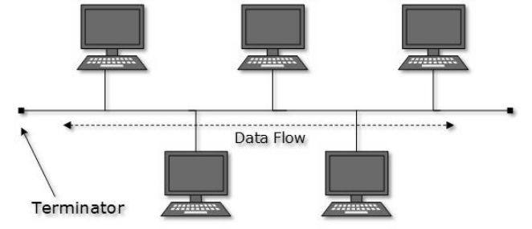
Bus Topology
In case of Bus topology, all devices share single communication line or cable. Bus topology may have problem while multiple hosts sending data at the same time.

Slide 13
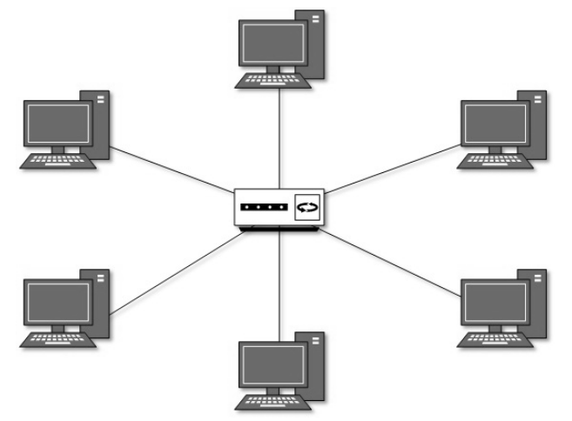
Star Topology
All hosts in Star topology are connected to a central device using a point-to-point connection. That is, there exists a point to point connection between hosts and hub.

Slide 14
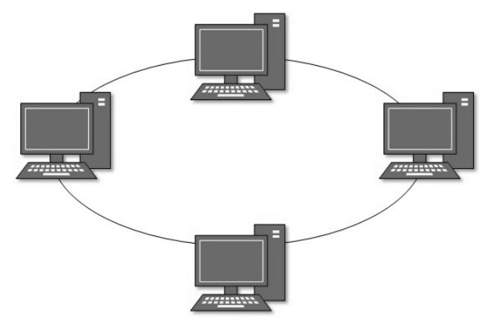
Ring Topology
In ring topology, each host connects to exactly two other machines, creating a circular network structure. When one host tries to communicate or send message to a host which is not adjacent to it, the data travels through all intermediate hosts.

Slide 15
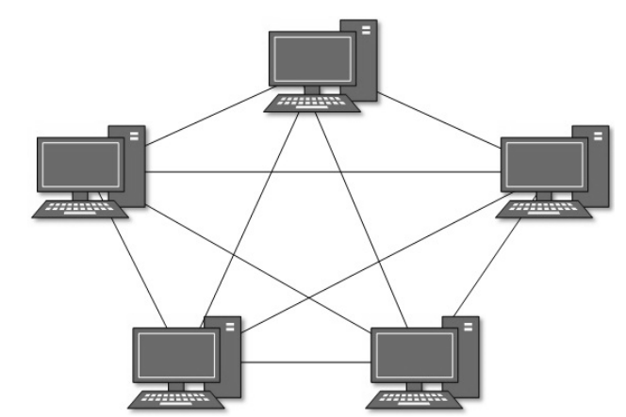
Mesh Topology
In this type of topology, a host is connected to one or multiple hosts. Mesh technology comes into two types
Full Mesh: All hosts have a point-to-point connection to every other host in the network.
Partially Mesh: Not all hosts have point-to-point connection to every other host.

Slide 16
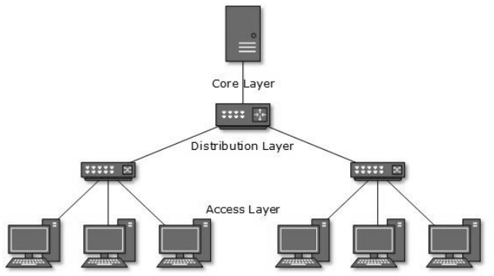
Tree Topology
Also known as Hierarchical Topology, this is the most common form of network topology in use presently.
This topology divides the network into multiple levels/layers of network.

Slide 17
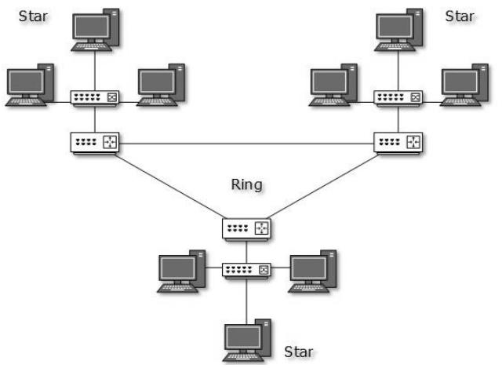
Hybrid Topology
A network structure whose design contains more than one topology is said to be hybrid topology.

Slide 18
Network Design Steps
Phase 3 – Physical Network Design
Select technologies and devices for campus networks
Select technologies and devices for enterprise networks

Slide 19
Network Design Steps
Phase 4 – Testing, Optimizing, and Documenting the Network Design
Test the network design
Optimize the network design
Document the network design

Slide 20
Types of Network Design
New network design
Re-engineering a network design
Network expansion design

Slide 21
New Network Design
Actually starting from scratch
No legacy networks to accommodate
Major driver is the budget, no compatibility issues to worry about

Slide 22
Re-engineering a Network Design
Modifications to an existing network to compensate for original design problems
Sometimes required when network users change existing applications or functionality
More of the type of problems seen today

Slide 23
Network Expansion Design
Network designs that expand network capacity
Technology upgrades
Adding more users or networked equipment

Slide 24
END

